Slide 1
05 Feb 2024
L-09
AGENDA:
Merge Sort
Quick Sort

Slide 2
MERGE SORT

Slide 3
MERGE SORT
Merge Sort is based on Divide Conquer and Combine(MERGE) Approach
Merge Sort uses MERGE operation to perform sorting

Slide 4
Merging Two Sorted List
Merge process will combine two sorted list List1 and List2 and produce third sorted list List3
m
n
LIST -1
LIST-2
LIST-3
m + n

Slide 5
Merging Two Sorted List
Initially
List-1
5 | 8 | 9
List-2
4 | 7 | 10
i
j
List-3
3 + 3 = 6
Pick the smaller element and place into list-3

Slide 6
Merging Two Sorted List
Step-1
List-1
5 | 8 | 9
List-2
4 | 7 | 10
i
j
List-3
4
3 + 3 = 6
Pick the smaller element and place into list-3

Slide 7
Merging Two Sorted List
Step-2
List-1
5 | 8 | 9
List-2
4 | 7 | 10
i
j
List-3
4 | 5
Pick the smaller element and place into list-3

Slide 8
Merging Two Sorted List
Step-3
List-1
5 | 8 | 9
List-2
4 | 7 | 10
i
j
List-3
4 | 5 | 7
Pick the smaller element and place into list-3

Slide 9
Merging Two Sorted List
Step-4
List-1
5 | 8 | 9
List-2
4 | 7 | 10
i
j
List-3
4 | 5 | 7 | 8 | 9
Pick the smaller element and place into list-3

Slide 10
Merging Two Sorted List
Step-5
List-1
5 | 8 | 9
List-2
4 | 7 | 10
i
j
List-3
4 | 5 | 7 | 8 | 9
Pick the smaller element and place into list-3

Slide 11
Merging Two Sorted List
Step-6
List-1
5 | 8 | 9
List-2
4 | 7 | 10
i
j
List-3
4 | 5 | 7 | 8 | 9 | 10
As List-1 is eunuchated and place rest of the elements of List-2 into list-3 one by one

Slide 12
Merging Two Sorted List
Merging Algorithm:
Create List-3 of size List-1 + List-2 .
Simultaneously traverse List-1 and List-2.
Pick smaller of current elements in List-1 and List-2 ,
copy this smaller element to the next position in List-3
and move ahead in List-3 and the List whose element is picked.
3. If there are remaining elements in List-1 or List-2 , copy them in List-3 .

Slide 13
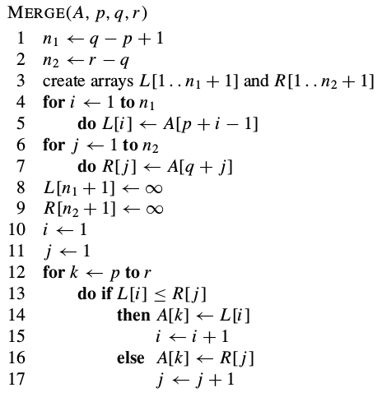
Merge Process

Slide 14
Merging Two Sorted List
Cost of merging 2 sorted list of size m and n
= O(m + n)

Slide 15
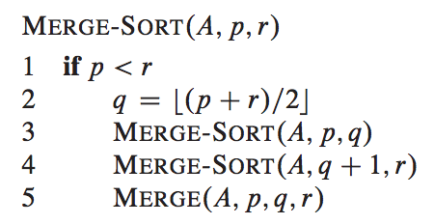
Merge Sort

Slide 16
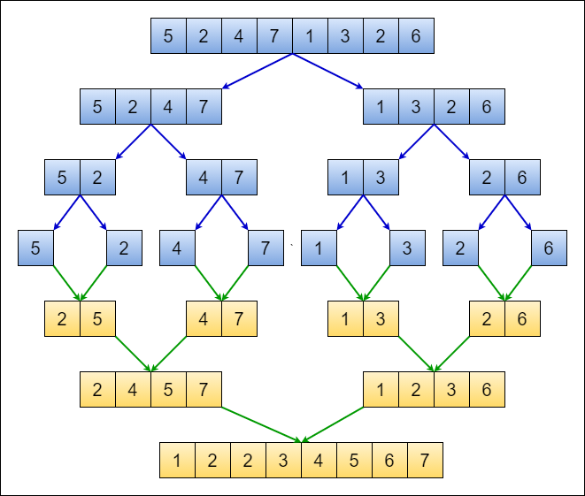
Unsorted
MERGE SORT
Sorted

Slide 17
Analyzing Merge Sort
T(n)
T(n/2)
T(n/2)
O(n)
Recurrence Relation:
T(n) = 2T(n/2) + O(n) = O(nlogn)
Note: Merge Sort is LEAST dependent on the order of input data set

Slide 18
Max-Min Problem
Max-Min Problem : Design a recurrence relation to compute the total number of comparisons for finding minimum and maximum simultaneously from a list A of n numbers
Solution:
No of Comparison = 0
Base Case 1 : if n =1 then min = max = A[0]
Base Case 2 : if n =2 then
if A[0] > = A[1]
min = A[1] and max = A[0]
else
min = A[0] and max = A[1]
No of Comparison = 1

Slide 19
Max-Min Problem
Recursive Case: if n > 2 Use divide conquer and combine approach
Divide the list into two half
Find min and max recursively of left half and right half
Find the min and max of entire list
A list of n numbers (n>2)
Left Half
Right Half
min_{L}, max_{L}
min_{R}, max_{R}
Min = minimum(min_{L}, min_{R})
Max = maximum(max_{L}, max_{R})
No of Comparison = 2

Slide 20
Max-Min Problem
9 | 7 | 20 | 10 | 11 | 6 | 1 | 21
D
I
V
I
D
E
C
O
N
Q
U
E
R
9 | 7 | 20 | 10
11 | 6 | 1 | 21
9 | 7
20 | 10
11 | 6
1 | 21

Slide 21
Max-Min Problem
Min =1; Max =21 , C = 2
9 | 7 | 20 | 10 | 11 | 6 | 1 | 21
C
O
M
B
I
N
E
Min =7
Max =20
C= 2
Min =1
Max =21
C= 2
9 | 7 | 20 | 10
11 | 6 | 1 | 21
9 | 7
20 | 10
11 | 6
1 | 21
Min =7
Max =9
C=1
Min =10
Max =20
C=1
Min =6
Max =11
C=1
Min =1
Max =21
C=1

Slide 22
Max-Min Problem
Recursive Case: if n > 2 Use divide conquer and combine approach
Divide the list into two half
Find min and max recursively of left half and right half
Find the min and max of entire list
A list of n numbers (n>2)
T(n)
T(n/2)
T(n/2)
Left Half
Right Half
min_{L}, max_{L}
min_{R}, max_{R}
Min = minimum(min_{L}, min_{R})
Max = maximum(max_{L}, max_{R})
No of Comparison = 2

Slide 23
Designing Recurrence Relation
T(n) = T(n/2) + T(n/2) + 2; T(2) = 1
T(n) = 2T(n/2) + 2; T(2) = 1

Slide 24






Designing Recurrence Relation
Solution: T(n) = 2T(n/2) + 2 ; T(2) =1
= 2[2T($\frac{n}{2^{2}}$) + 2] + 2
As $T\left(\frac{n}{2}\right)=2T\left(\frac{n}{2^{2}}\right) + 2$
= $2^{2}T\left(\frac{n}{2^{2}}\right)+ 2^{2} +2$
= $2^{2}\left[2T\left(\frac{n}{2^{3}}\right) + 2\right] + 2^{2} + 2$
As $T\left(\frac{n}{2^{2}}\right)=2 T\left(\frac{n}{2^{3}}\right) + 2$
= $2^{3}T\left(\frac{n}{2^{3}}\right)+2^{3} + 2^{2} + 2$
.
.
.
= $2^{i}T\left(\frac{n}{2^{i}}\right)+2^{i}+2^{i−1}+…………… + 2^{3} + 2^{2} + 2$

Slide 25




= $2^{i}T\left(\frac{n}{2^{i}}\right)+2^{i}+2^{i−1}+…………… + 2^{3} + 2^{2} + 2$
$$\frac{n}{2^{i}} = 2 → n=2.2^{i}= 2^{i+1}$$
Remember the base case T(2) = 1
= $2^{i}T\left(2\right)+2^{i}+2^{i−1}+…………… + 2^{3} + 2^{2} + 2$
= $2^{i}∗1+2^{i}+2^{i−1}+…………… + 2^{3} + 2^{2} + 2$
= $2^{i}+2^{i}+2^{i−1}+…………… + 2^{3} + 2^{2} + 2$
$$S_{n }=a+ar+ar^{2}+ar^{3}+ ….+ar^{n−1} = \frac{a(r^{n}−1)}{r−1}$$
$$= 2+ 2^{2} + 2^{3}+ ……………. + 2^{i−1} + 2^{i} + 2^{i}$$
$$=2\{ 1+ 2+ 2^{2} + 2^{3}+ ……………. + 2^{i−1}\} + 2^{i}$$
=2[ $\frac{1(2^{i} −1)}{2−1} ]+2i$
= $\frac{(2^{i+1} −2)}{1} +2^{i}$
$$\frac{n}{2^{i}} = 2 → n=2.2^{i}= 2^{i+1}$$
= $2^{i+1} −2 + 2^{i}$
= $\frac{3n}{2} −2$
= n - 2 + $\frac{n}{2}$
= O(n)

Slide 26
QUICK SORT

Slide 27
QUICK SORT
Quick Sort is also based on Divide and Conquer Approach.
Quick sort uses PARTITION process to perform sorting
Developed by Tony Hoar in 1959
Also known as Partition Exchange Sort

Slide 28
Partition Process QUICK SORT
Goal: The goal is to find the correct position for the pivot in the sorted array.
Step-1
Choose the pivot element from given Array(HOW?)
Step-2
Perform Partitioning : rearranging the elements in the array so that elements smaller than the pivot are moved to its left, and elements greater than the pivot are moved to its right.

Slide 29
How to pick pivot element?
A critical decision that can significantly impact the efficiency of the sorting process
Some common strategies
1. First or last element :
10 | 5 | 12 | 1 | 9 | 8 | 20 | 3 | 6 | 23
Pivot Element

Slide 30
How to pick pivot element?
A critical decision that can significantly impact the efficiency of the sorting process
Some common strategies
1. First or last element :
10 | 5 | 12 | 1 | 9 | 8 | 20 | 3 | 6 | 23
Pivot Element
2. Random element :
10 | 5 | 12 | 1 | 9 | 8 | 20 | 3 | 6 | 23
Pivot Element

Slide 31
How to pick pivot element?
3. Median of 3 elements :
10 | 5 | 12 | 1 | 9 | 8 | 20 | 11 | 6 | 23 | 15
Median = 10
10 | 5 | 12 | 1 | 9 | 8 | 20 | 11 | 6 | 23 | 15
Pivot Element

Slide 32
Partition Process
Initially:
Pivot
If A[L] ≤ Pivot
Left
L
R
Right
If A[R] > Pivot

Slide 33
Partition Process
During:
Pivot | ≤ Pivot |  | > Pivot
L
R
Finally:
≤ Pivot | Pivot | > Pivot
Correct Position of Pivot

Slide 34
Partition Process
Smaller or Equal
Larger
≤ Pivot | Pivot | ≥ Pivot

Slide 35
Partition Process
Pivot
10 | 5 | 12 | 1 | 9 | 8 | 20 | 3 | 6 | 23
L
R
5 < Pivot =10
Increment L

Slide 36
Partition Process
10 | 5 | 12 | 1 | 9 | 8 | 20 | 3 | 6 | 23
L
R
12 > Pivot =10
STOP

Slide 37
Partition Process
10 | 5 | 12 | 1 | 9 | 8 | 20 | 3 | 6 | 23
L
R
23 > Pivot =10
Decrease R

Slide 38
Partition Process
10 | 5 | 12 | 1 | 9 | 8 | 20 | 3 | 6 | 23
L
R
6 < Pivot =10
STOP

Slide 39
Partition Process
Swap
10 | 5 | 12 | 1 | 9 | 8 | 20 | 3 | 6 | 23
L
R
10 | 5 | 6 | 1 | 9 | 8 | 20 | 3 | 12 | 23
L
R

Slide 40
Partition Process
10 | 5 | 6 | 1 | 9 | 8 | 20 | 3 | 12 | 23
L
R
6 < Pivot =10
Increment L
10 | 5 | 6 | 1 | 9 | 8 | 20 | 3 | 12 | 23
L
R
1 < Pivot =10
Increment L

Slide 41
Partition Process
10 | 5 | 6 | 1 | 9 | 8 | 20 | 3 | 12 | 23
L
R
9 < Pivot =10
Increment L
10 | 5 | 6 | 1 | 9 | 8 | 20 | 3 | 12 | 23
L
R
8 < Pivot =10
Increment L

Slide 42
Partition Process
10 | 5 | 6 | 1 | 9 | 8 | 20 | 3 | 12 | 23
L
R
20 > Pivot =10
Stop
10 | 5 | 6 | 1 | 9 | 8 | 20 | 3 | 12 | 23
L
R
12 > Pivot =10
Decrement R

Slide 43
Partition Process
10 | 5 | 6 | 1 | 9 | 8 | 20 | 3 | 12 | 23
L
R
3 < Pivot =10
Stop
Swap
10 | 5 | 6 | 1 | 9 | 8 | 20 | 3 | 12 | 23
L
R
10 | 5 | 6 | 1 | 9 | 8 | 3 | 20 | 12 | 23
L
R

Slide 44
Partition Process
10 | 5 | 6 | 1 | 9 | 8 | 3 | 20 | 12 | 23
L
R
3 < Pivot =10
Increment L
L
10 | 5 | 6 | 1 | 9 | 8 | 3 | 20 | 12 | 23
R
20 > Pivot =10
Stop

Slide 45
Partition Process
L
10 | 5 | 6 | 1 | 9 | 8 | 3 | 20 | 12 | 23
R
20 > Pivot =10
Decrement R
L
10 | 5 | 6 | 1 | 9 | 8 | 3 | 20 | 12 | 23
R
3 < Pivot =10
Stop

Slide 46
Partition Process
L
10 | 5 | 6 | 1 | 9 | 8 | 3 | 20 | 12 | 23
R
As L and R has crossed each other
Swap
L
10 | 5 | 6 | 1 | 9 | 8 | 3 | 20 | 12 | 23
R

Slide 47
Partition Process
Pivot
3 | 5 | 6 | 1 | 9 | 8 | 10 | 20 | 12 | 23
Less Than Pivot
More Than Pivot
The Cost of Partition: O(n)

Slide 48
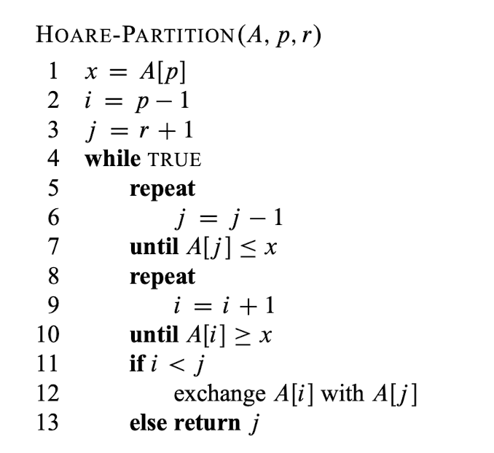
PIVOT
Left Pointer
Right Pointer
Partition Process
Index of pivot

Slide 50
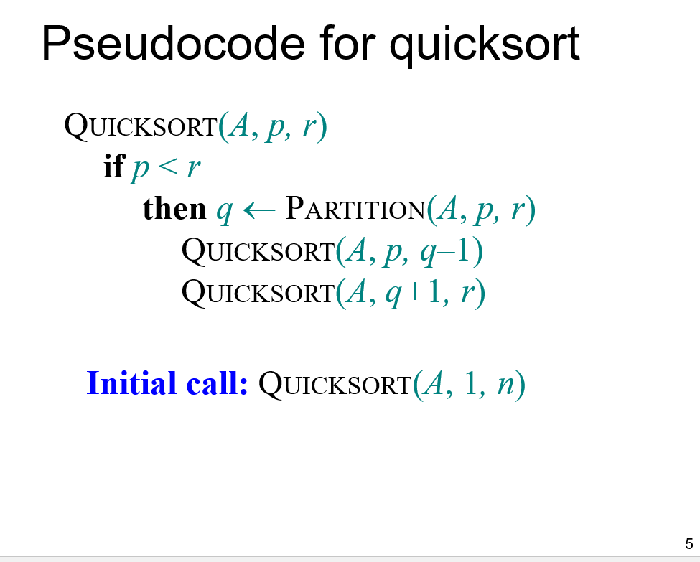
Quick Sort

Slide 51
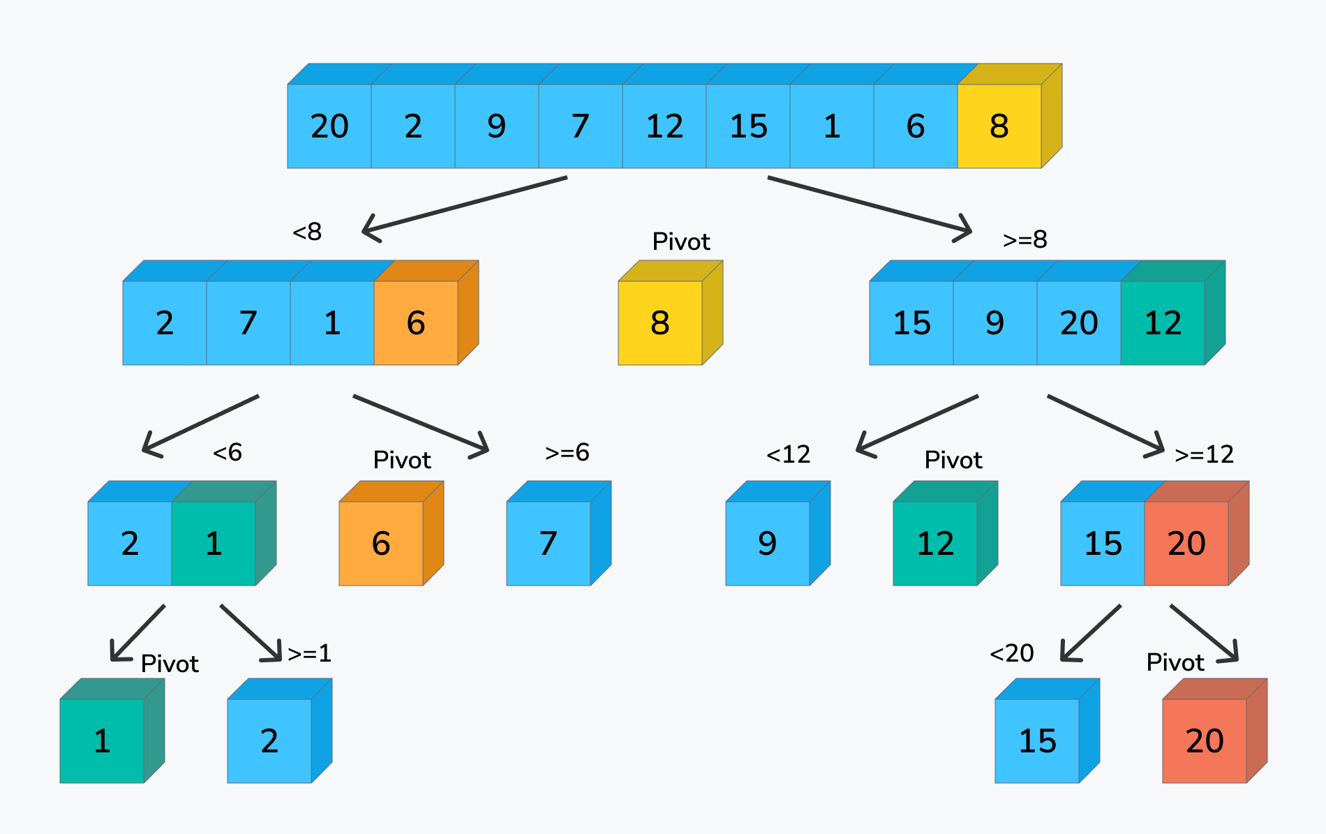
Quick Sort

Slide 52
Quick Sort: Worst case
If the data is Sorted
1
2
3
4
5
The Recurrence Relation is
T(n) = T(0) + T(n - 1) + O(n)
1
2
3
4
5
= O(n²)
T(n) = T(n-1) + O(n)
2
3
4
5
3
4
5
4
5

Slide 53
Quick Sort: Worst case
If the data is Reverse Sorted
5
4
3
2
1
4
3
2
1
5
The Recurrence Relation is
T(n) = T(n-1) + T(0) + O(n)
3
2
1
4
T(n) = T(n-1) + O(n)
2
1
3
= O(n²)
1
2

Slide 54
Quick Sort: Best Case
If the Partition process divides the data set in almost equal half
n
The Recurrence Relation is
n/2
n/2
T(n) =T(n/2) +T(n/2) + O(n)
T(n) =2T(n/2) + O(n)
n/4
n/4
n/4
n/4
T(n) =O(nlogn)

Slide 55

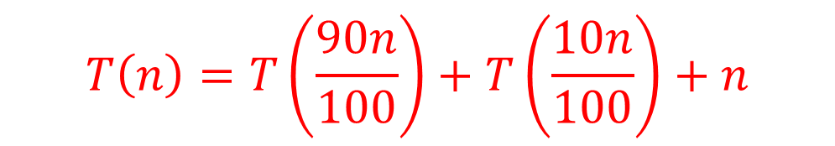
Quick Sort: Best Case
If the Partition process divides the data set as follows
n
The Recurrence Relation is
90%
10%
$$T\left(n\right)=T\left(\frac{90n}{100}\right)+T\left(\frac{10n}{100}\right)+n$$
$$T\left(n\right)=T\left(\frac{9n}{10}\right)+T\left(\frac{n}{10}\right)+n$$
90%
10%
90%
10%
T(n) =O(nlogn)

Slide 56
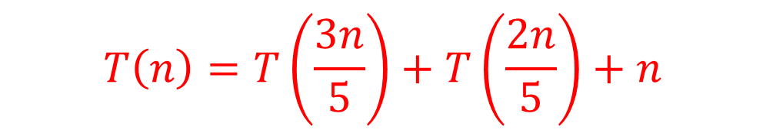
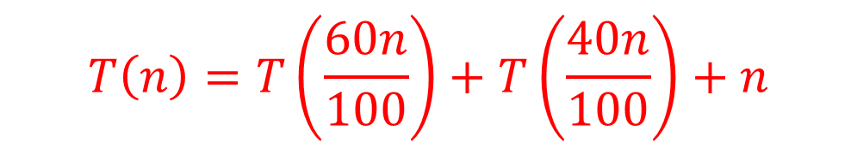
Quick Sort: Best Case
If the Partition process divides the data set as follows
n
The Recurrence Relation is
60%
40%
$$T\left(n\right)=T\left(\frac{60n}{100}\right)+T\left(\frac{40n}{100}\right)+n$$
$$T\left(n\right)=T\left(\frac{3n}{5}\right)+T\left(\frac{2n}{5}\right)+n$$
60%
40%
60%
40%
T(n) =O(nlogn)

